Slide 1
Diver Meal
Providing personal, nutritious, and diverse
meal recommendation.
By: Vasu Arora
shrisw2002@gmail.com

Slide 2

Greeting
Welcome to The Diver Meal
According to USDA, 17.1 million people live in low income and low access tracts called food deserts .
By offering nutritious food options, Diver Meal can reduce the risk of people developing generational disorders, such as obesity, diabetes, and heart disease.

Slide 3
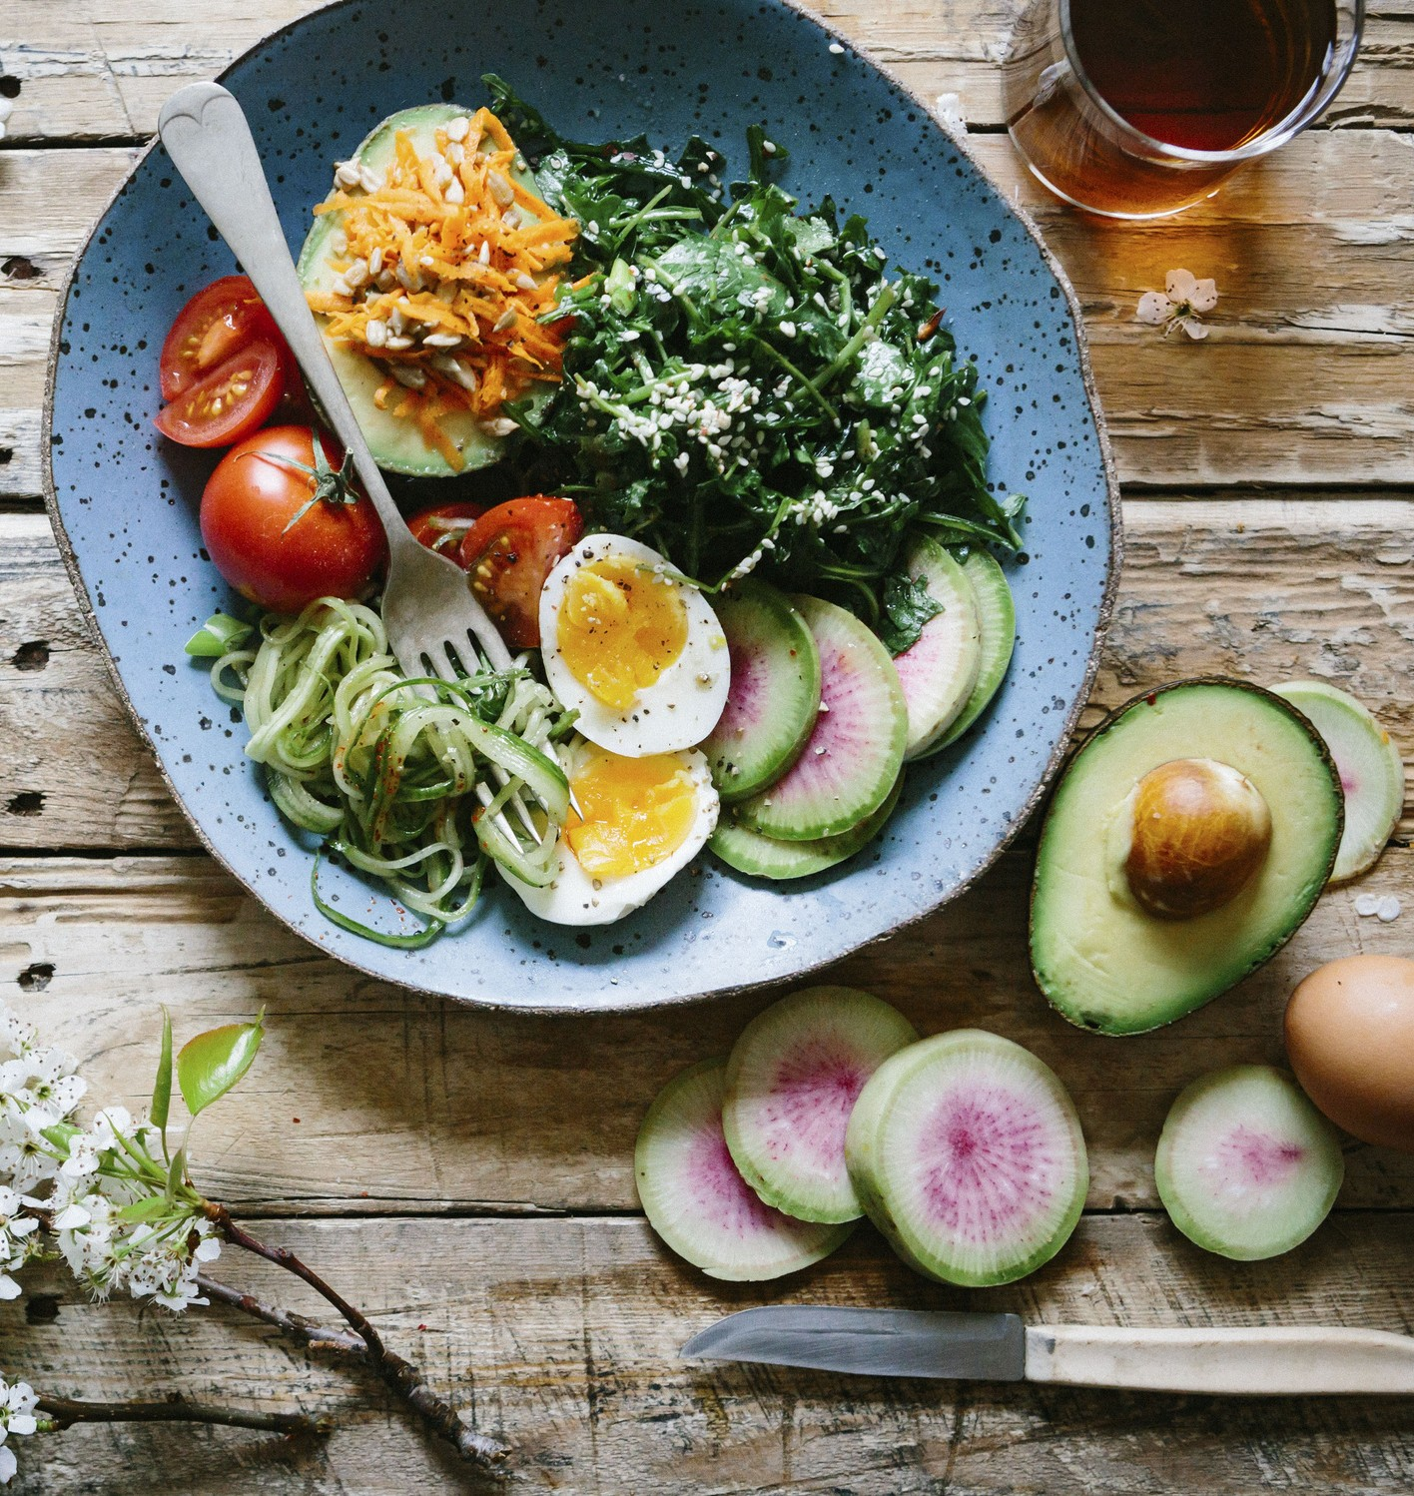
What it does ?
One of the key features of Diver Meal is its personalized meal
planning.
By offering a wide variety of recipes that match the user's preferences, the app can help people discover new cuisines and ingredients that they may not have tried before.
By allowing users to take pictures of the food items they have in their homes, diversified can provide customized and nutritious recommendations for meals and snacks, preventing food waste and promoting healthy eating habits.

Slide 4
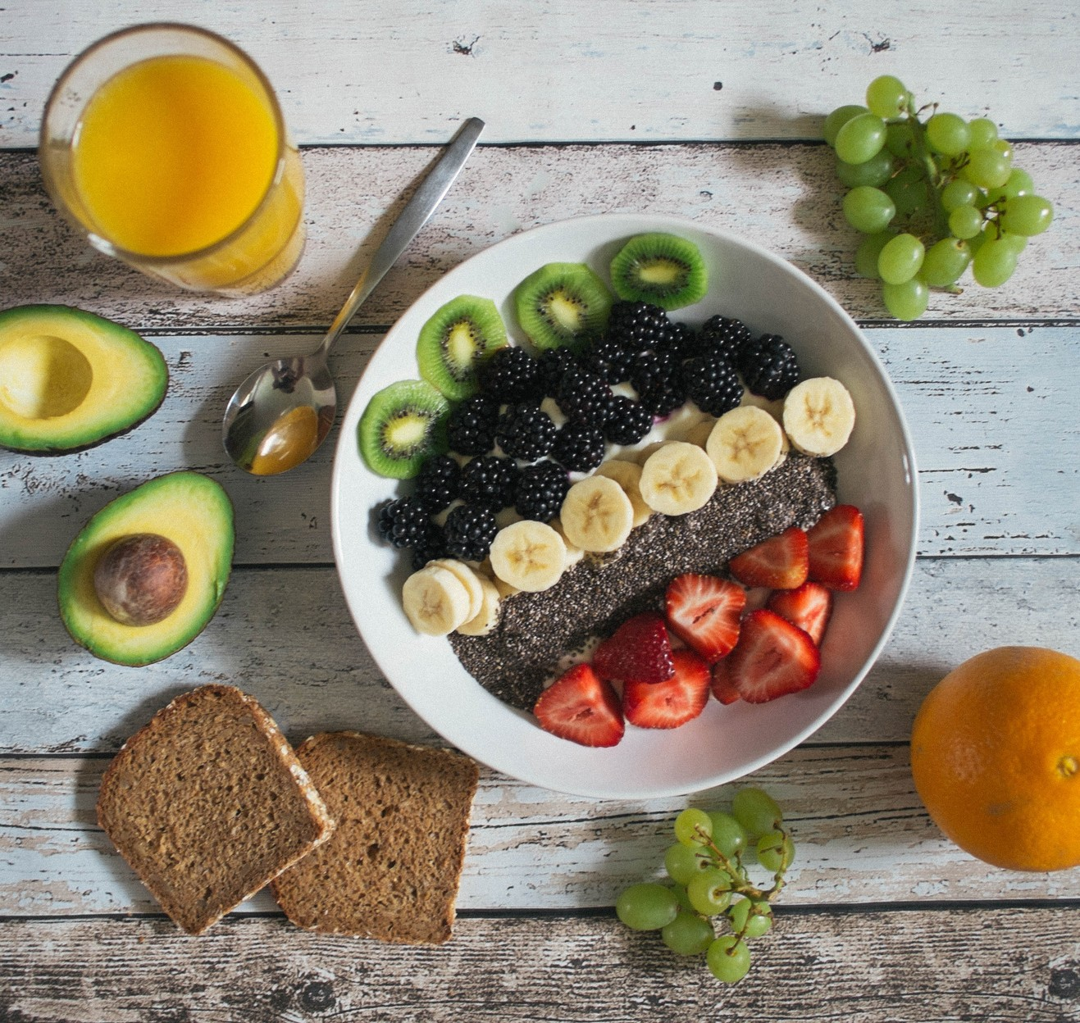
How I built it
Our Mobile Application:
Uses Tasty's API to find nutritious , personal recipies.
Uses react native to create an elegent, user friendly Interface.
Uses Roboflow and flask to detect ingredients around the household.
Utilizes Google's | Firebase | for
Authentication.
Utilizes transfer learning | with Keras | and
Tensorflow.

Slide 5


Accomplishments
I wanted to create an application that can be
scaled to help many people living in food deserts, and Diver Meal accomplishes this task.

Slide 6

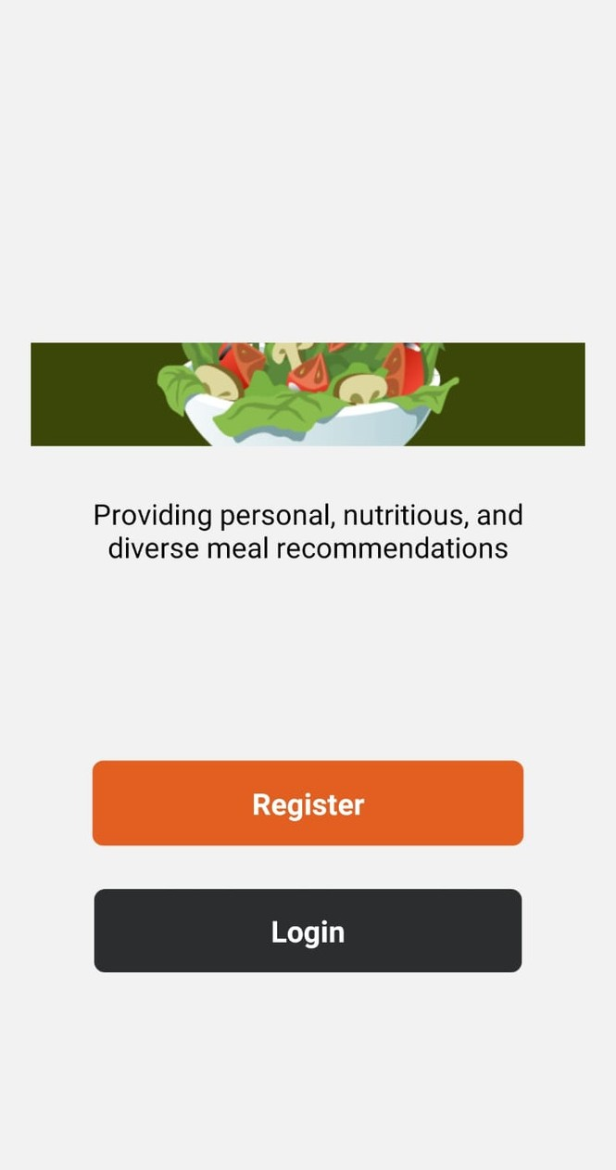

Register Now

Slide 7

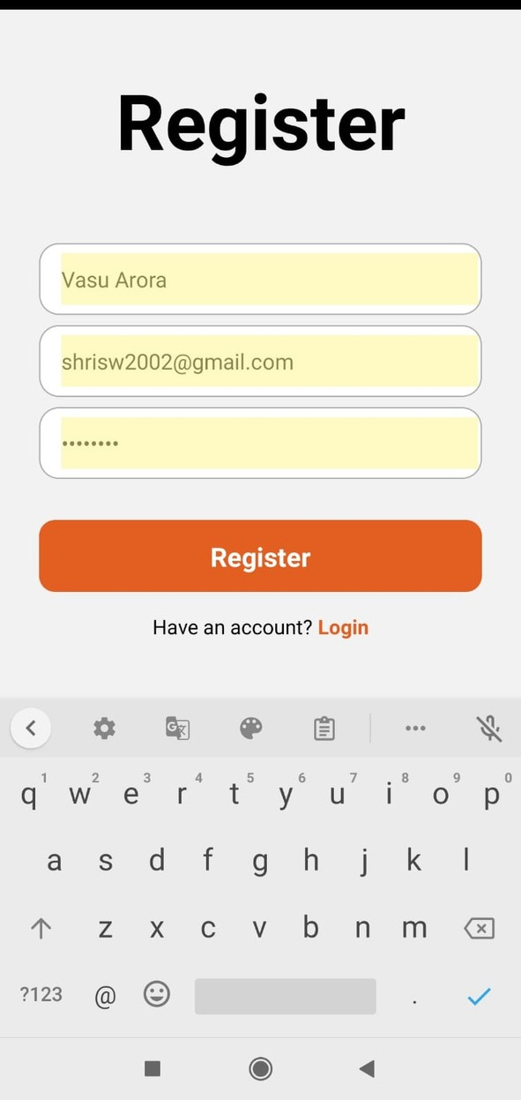

Register Now

Slide 8

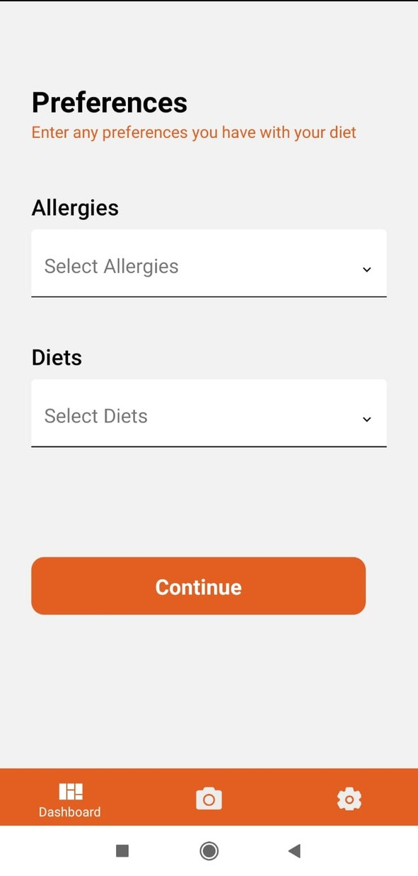

Select Preferences

Slide 9

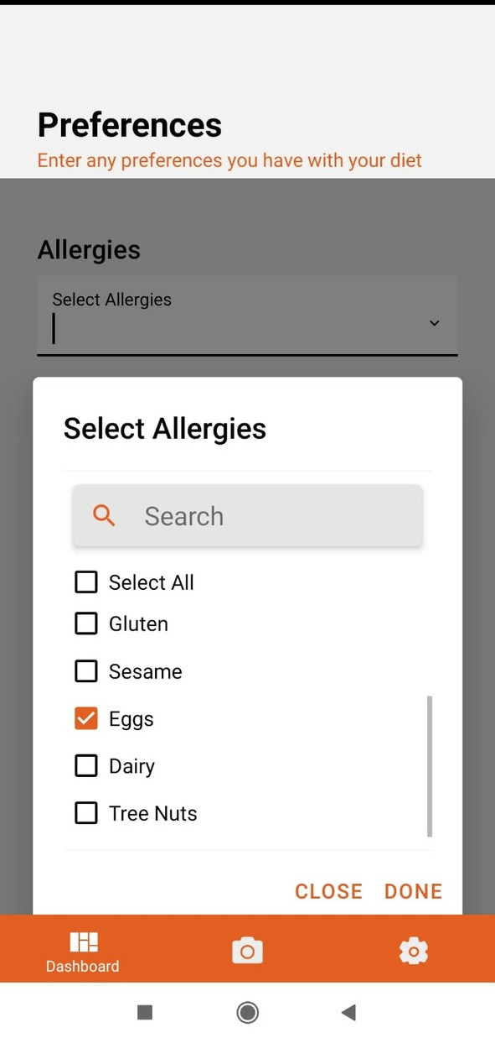

Select Preferences

Slide 10

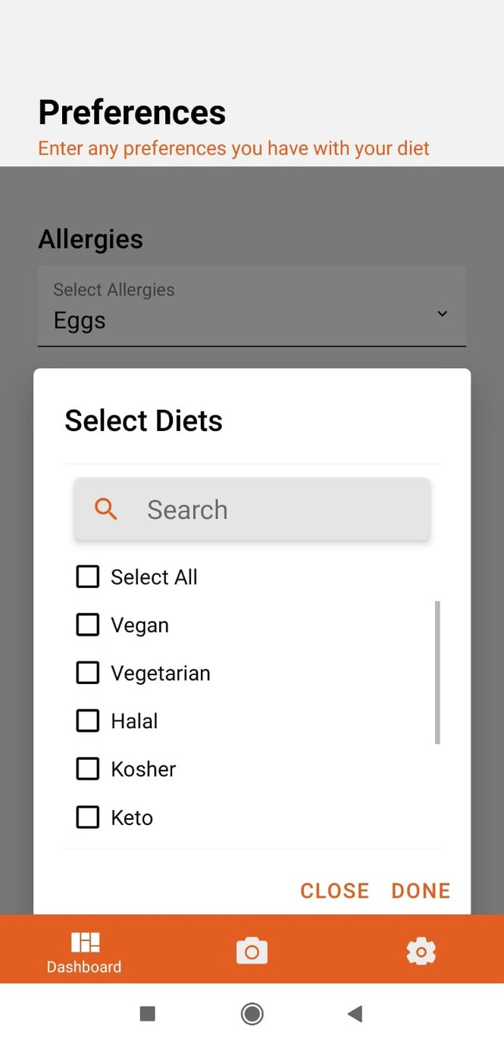

Select Preferences

Slide 11
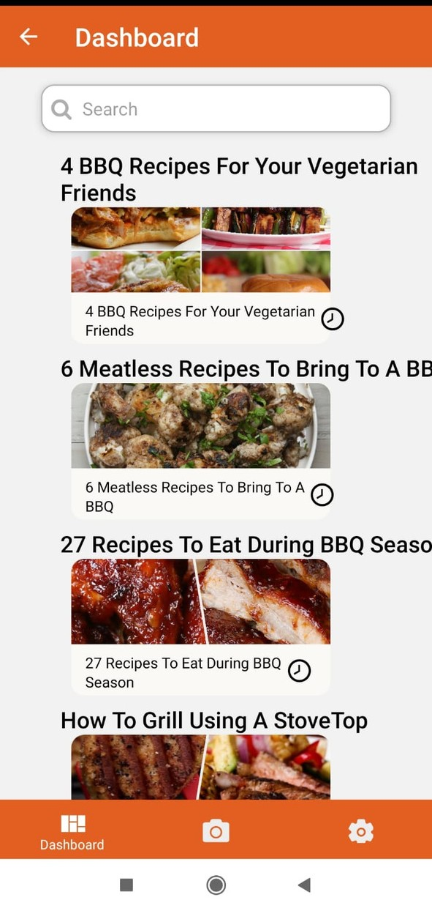
Dashboard

Slide 12
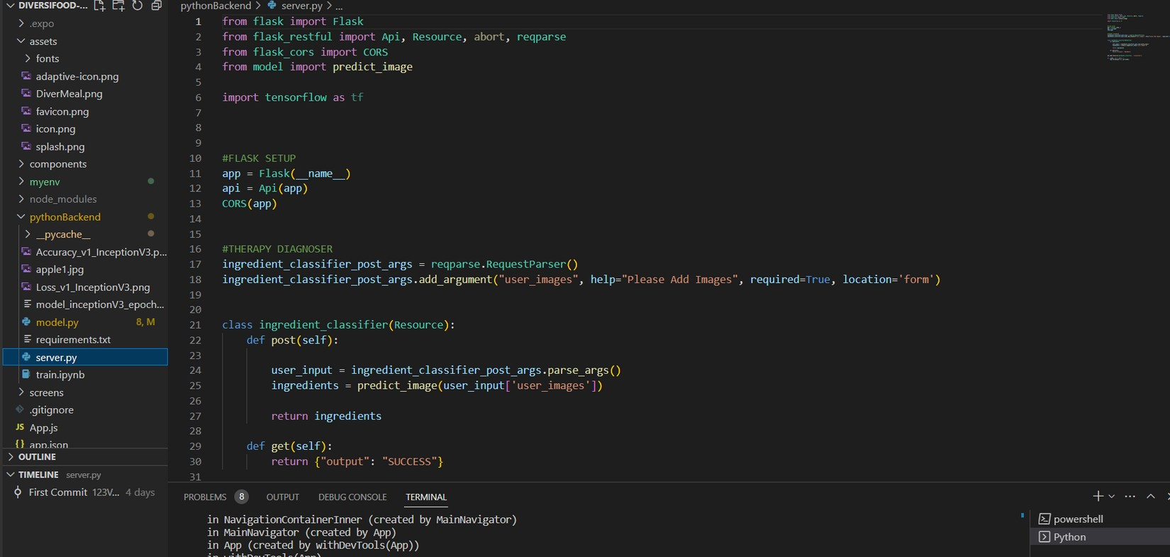
Code

Slide 13
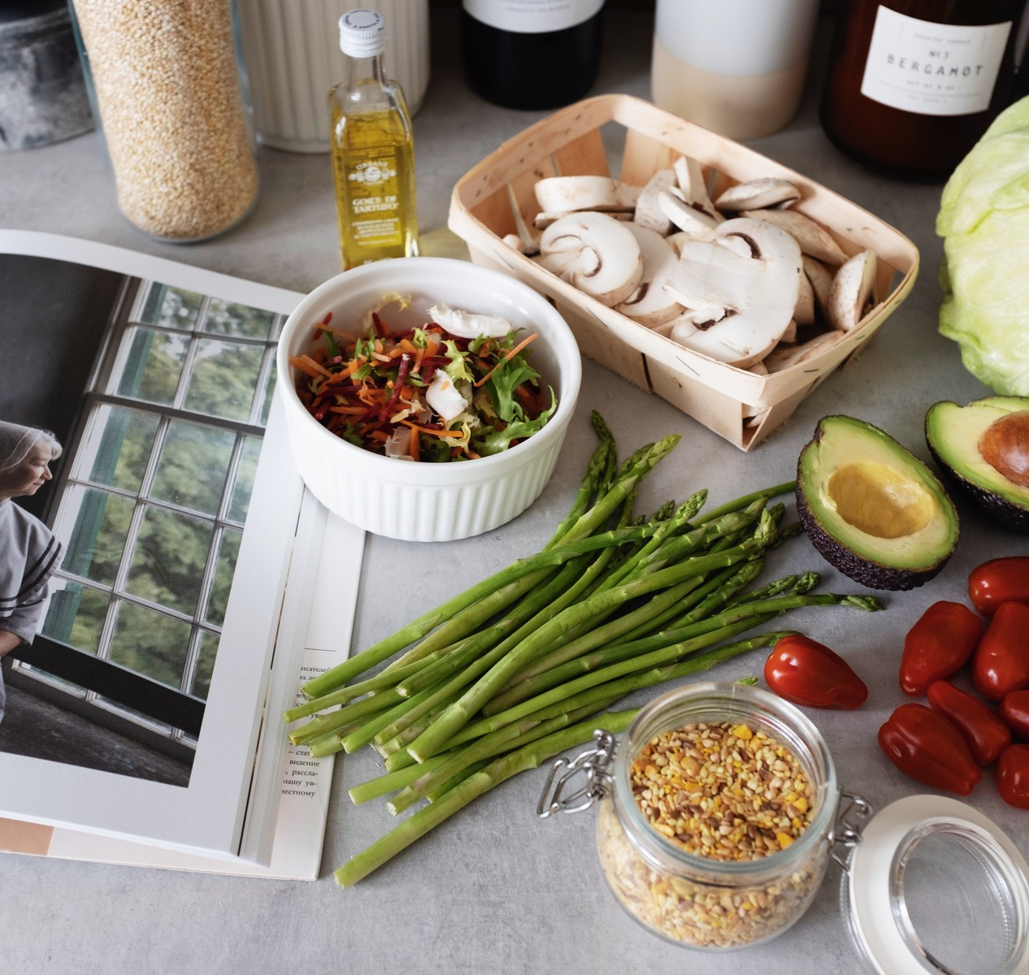
Future Plans
Allow people to create a shopping list
for the items they need for a certain recipe telling them where they can find it .
Adding like feature where people can like their favorite foods and view them for later.
Publishing to Google play store.

Slide 14
Monetization Model
Our Model will use the user data like Allergies and user food preferences to show sponsored advertisements.
Our Model will use user browser history to show targeted advertisements.
Paid Membership Model to remove advertisements and access to fast servers and customer support.

Slide 15

GITHUB
LINK
https://github.com/123Vasu/DiverMeal

Slide 16



Thank you!

